Slide 1

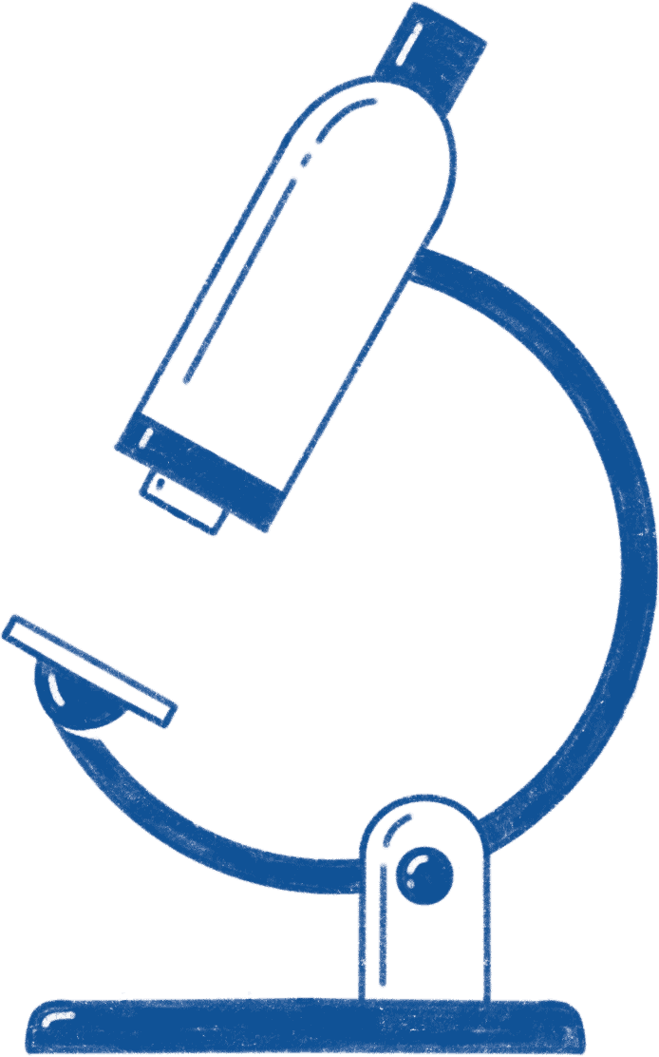

A COMPETITIVE STUDY OF MACHINE LEARNING TECHNIQUES FOR CLASSIFYING THYROID DISORDERS
Thesis Defense
Sara Sajid Undre 映月 201969990298

Slide 2


01
Thyroid Disorder
Dysfunction of the thyroid gland resulting in imbalances of hormone production and regulation.

Slide 3
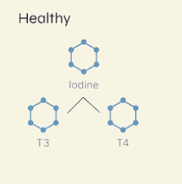
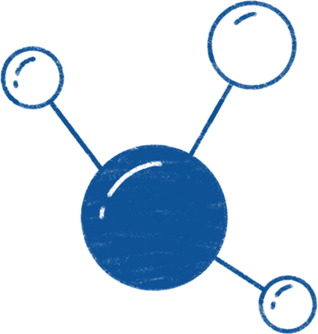
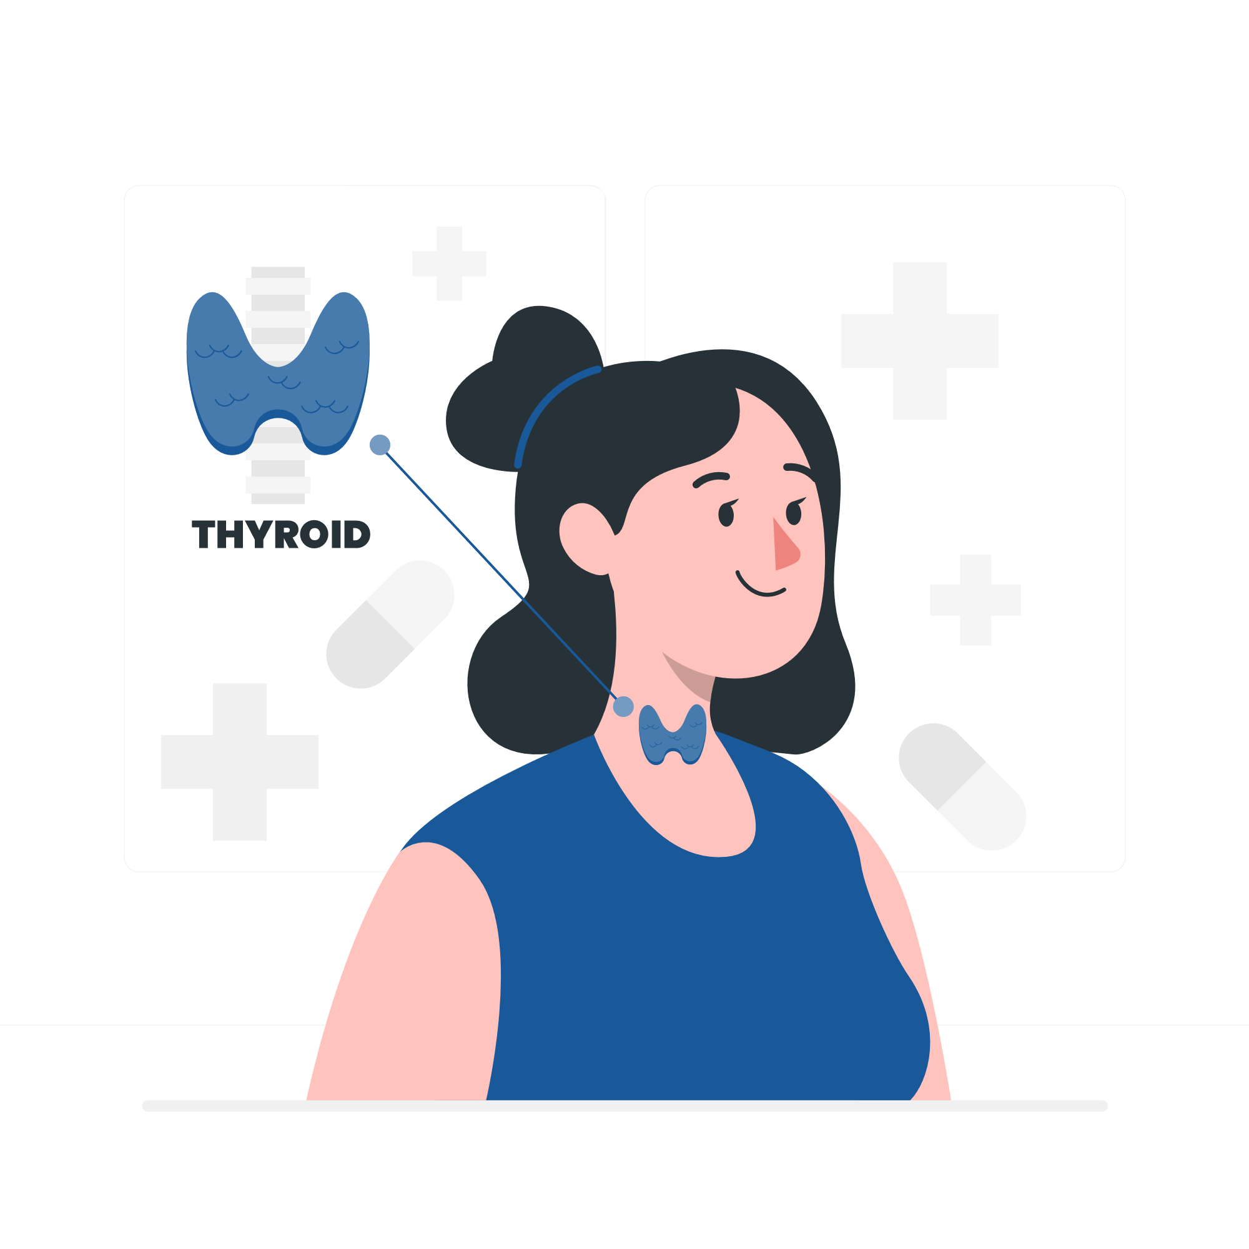
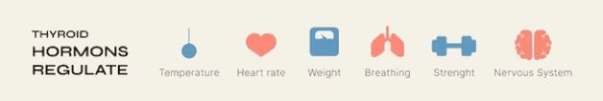
Thyroid Disorder
HEALTHY
EUTHYROIDISM
HYPOTHYROID
HYPERTHYROID

Slide 4
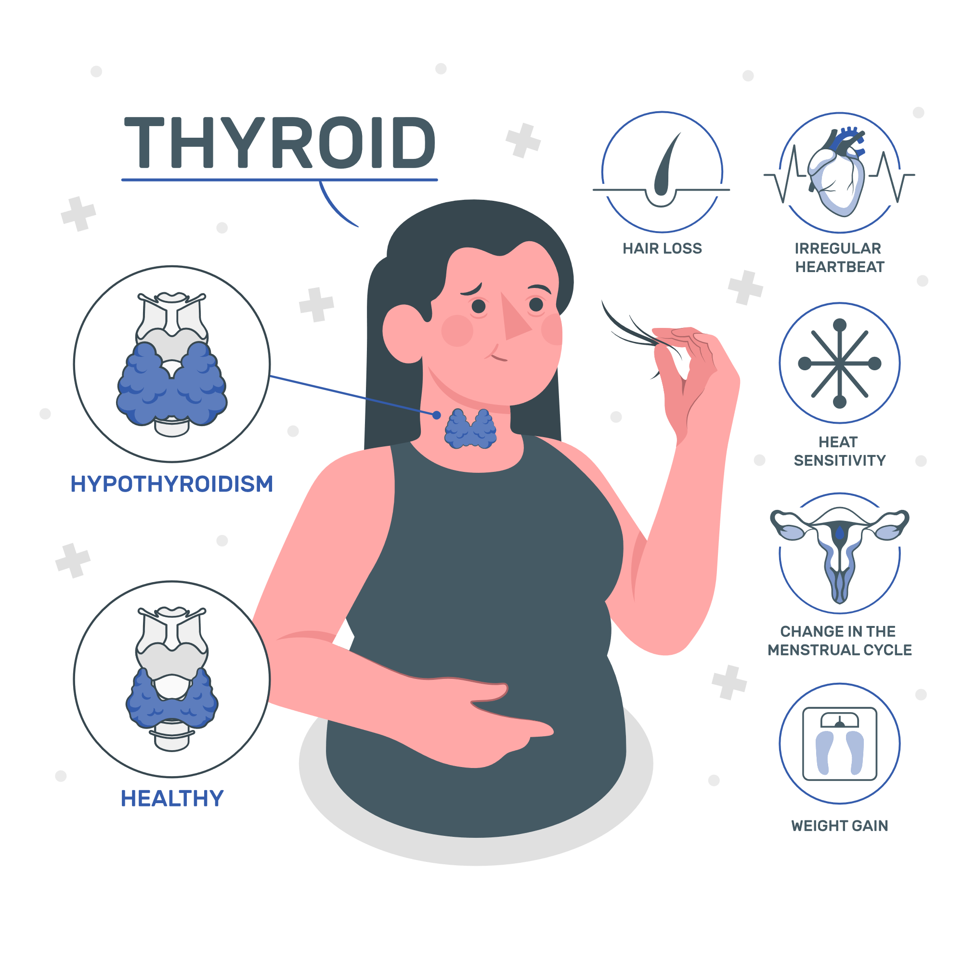

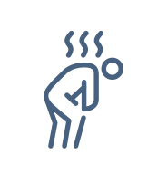








Hypothyroid
T3 & T4
FATIGUE
CONSTIPATION

Slide 5


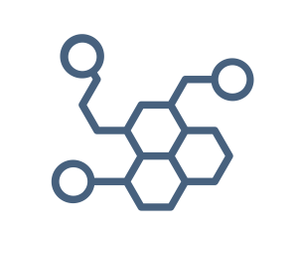





Hyperthyroid
T4
WEIGHT LOSS
EXCESSIVE
SWEATING
EXCESSIVE HORMONE PRODUCTION

Slide 6
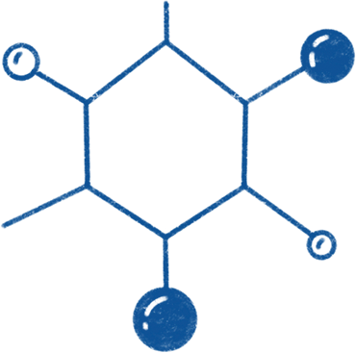

02
Hypothesis
Enhancing Performance through Dataset Pre-processing and Model Fine-tuning

Slide 7

03
Objectives
Establishing Goals and Strategies for Thyroid Disorder Classification using Machine Learning.

Slide 8
Study Objectives
Collect
Pre-process
Gather and compile a thorough thyroid disorder case dataset.
Employ data pre-processing methods to enhance dataset quality and relevance
Explore
Train & Evaluate
Investigate and select most informative feature characteristics for classification.
Conduct training and evaluation of different machine learning algorithms on the dataset.
Compare
Assess and compare the performance of the machine learning algorithms.

Slide 9
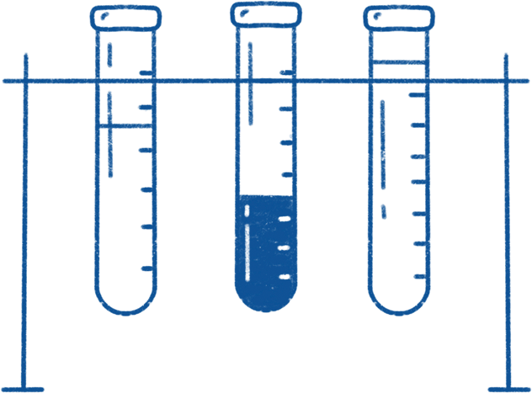
04
Methodology
Proposed Framework for thyroid disorder classification.

Slide 10
Methodology
1
3
Model Development
Data collection & Processing
Thyroid Dataset from UCI Machine Learning Repository: Data Cleaning, Integration, and Dimension Reduction
Train-Test Split and Development of Machine Learning Models
Proposed Framework
2
4
Feature Engineering
Model Evaluation
Skew Data Transformation, Encoding, and Handling Multicollinearity
Evaluation Metrics for Model Performance: Accuracy, Recall, Precision, F1-Score,and Loss Functions

Slide 11

Data collection & Processing
Data Cleaning
Enhancing data format clarity.
Eliminating outlier from the dataset.
Imputing missing data values
Data Integration
Merging subclasses into superclass categories in the Hypothyroid and Hyperthyroid datasets.
The integration of the Hypothyroid dataset and the Hyperthyroid dataset into a unified thyroid dataset.
Dimension Reduction
Eliminating redundant and irrelevant feature attributes.

Slide 12

Feature Engineering
Visual correlation analysis:
Correlation matrices and dendrogram.
VIF analysis:
Remove feature with highest VIF value.
Transform skewed data using log & square root transformation
02
Multicollinearity
Transformation
01
03
Encoding
Convert categorical features to numerical
Map Dependent target features:
Hyperthyroid- 0
Hypothyroid - 1
Euthyroid(negative)- 2

Slide 13
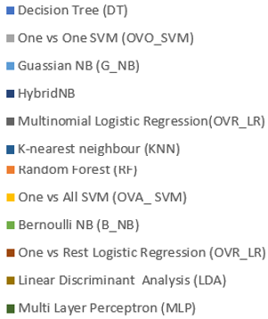
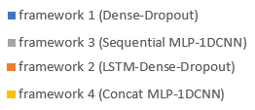
Model Development
ML CLASSIFIERS
THYROID DATASET
Train & Test dataset split
Kmeans Smote Sampled
Smote Sampled
Neural Network
NN FRAMEWORKS
Machine Learning Model
Neural Network Framework
Train Model
Model Evaluation
Hypertuning ML model using GridSearchCV

Slide 14
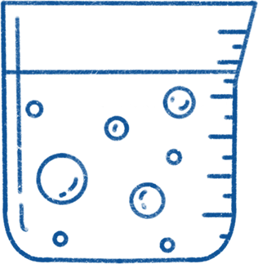
05
Analysis
ML model comparison result and inference.

Slide 15
Superiority of Ensemble Methods
Novel HybridNB model
Combines multiple decision tree
Combination of Gaussian & Bernoulli Naïve Bayes
Feature Selection
Selection of the most relevent features
Comparative Performance
Addressing Imbalanced data
Best Model:
Random Forest
Employ SMOTE & K-means SMOTE techniques

Slide 16
90%
Models trained using a K-means SMOTE-sampled dataset demonstrated superior performance.

Slide 17
Best Model Result
Highest Accuracy
Improved accuracy in Framework 2 & 4
with increased epochs.
Decreased accuracy in Framework 1 & 3
with more epochs.

Slide 18


Conclusions
Enhance Accuracy
Efficient Diagnose
Better ML Models
Future Direction

Slide 19

Thank you!
Do you have any questions?
201969990298@mail.scut.edu.cn
sarahundre12@gmail.com
Wechat Id: sarahundre

